Slide 1


CAPSTONE PROJECT 2
HEART DISEASE DETECTION USING CLASSIFICATION ALGORITHMS
Team Members
T170800208: Kiran Satish Belsare
T170800231: Sakshi Shivaji Kanade
T170800220: Janhavi Deepak Dhanawade
T170800212: Gayatri Pathade
T170800242: Anushka Kishor Bairagi
T170800202: Aishwarya Laxman Zanjad

Slide 2
Table of Contents
•
Problem Statement
•
Model Building & Training
•
Project Overview
•
Model Evaluation & Performance Analysis
•
Data generation & Loading
•
Model Comparison
•
Data Exploration & Understanding
•
Stream API Deployment (Streamlit)
•
Exploratory Data Analysis
•
Docker Deployment
•
Data Preprocessing & Feature Engineering
•
Conclusion

Slide 3
Problem Statement
Heart disease is one of the leading causes of death worldwide. Early and accurate detection through diagnostic screening can significantly improve patient survival rates and reduce healthcare costs.
This project aims to build machine learning models that predict the presence of heart disease based on patients' demographic, clinical, and diagnostic test data, enabling healthcare professionals to make timely and informed decisions.
You are working with clinical health data to develop a system for early heart disease risk prediction.
The task is to build a Machine Learning classification model that predicts whether a person is likely to have heart disease based on clinical and physiological parameters.
The system uses features such as age, sex, chest pain type, blood pressure, cholesterol, maximum heart rate, exercise-induced angina, and ST-related measurements.
The goal is to provide quick and reliable predictions that can support early risk assessment and help users understand potential heart disease risk.

Slide 4
Overview of the Project
•
Develop and compare multiple classification algorithms to predict heart disease risk.
•
Models include: Logistic Regression, Decision Tree, Random Forest, and SVM.
•
Data preprocessing utilizes an 80:20 stratified Train/Test split inside a Scikit-learn Pipeline.
•
Performance evaluation focuses heavily on Recall (Sensitivity) to minimize false negatives (missed diagnoses).
•
The final tuned Random Forest model is deployed via a Streamlit web application.
•
The entire application is containerized using Docker and deployed with GitHub Actions for CI/CD.

Slide 5
Data generation & Loading
•
Dataset Name: heart_disease_dataset
•
Dataset Size: 900 records of patient clinical data
•
Target Variable: heart_disease (0 = No Heart Disease, 1 = Heart Disease)
•
Key Features:
○
Demographics: Age, Sex
○
Vitals/Labs: Resting Blood Pressure, Cholesterol, Fasting Blood Sugar, Max Heart Rate
○
Clinical: Chest Pain Type, Resting ECG, Exercise-Induced Angina, ST Depression, ST Slope, Num Major Vessels, Thalassemia
•
Data stored in CSV format for reproducibility.

Slide 6
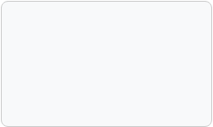
Data Exploration & Understanding
•
The dataset contains 13 predictive features and 1 class label.
•
Data Quality Check:
○
No missing values present in the dataset.
○
Handling missing values is not required.
Data Split Strategy
Training Set: 80%
○
Data is complete and ready for analysis.
Testing Set: 20%
•
Formatting: Data is already in numerical format, meaning no explicit categorical encoding techniques (like One-Hot Encoding) are strictly required prior to modeling.

Slide 7
Exploratory Data Analysis
•
Target Distribution: Checked class balance between disease and no-disease patients to identify potential class imbalance issues.
•
Feature Distributions: Analyzed Age, Cholesterol, and Resting Blood Pressure via histograms to understand data spread.
•
Correlation Matrix: Found relationships among variables (e.g. checking for multicollinearity) using a heatmap.
•
Key Insights:
○
Observed specific age trends related to heart disease presence.
○
Analyzed specific Chest Pain Types associated with higher risk.

Slide 8
Data Preprocessing & Feature Engineering
•
Handling Missing Values: Data was complete; no imputation was necessary.
•
Scaling Features:
○
Features have different ranges (e.g., Cholesterol in 200s, ST Depression in small decimals).
○
Standard scaling was applied within the Scikit-learn Pipeline so the model treats them fairly.
•
Splitting Data:
○
Divide data into training set (80%) and test set (20%) using a stratified split.
○
Training set → teach the model.
○
Test set → check if the model works on new data.
○
Use a fixed random state to ensure reproducibility.

Slide 9
Model Building & Training
•
Classification Algorithms Used:
○
Logistic Regression: A foundational linear model for binary classification.
○
Decision Tree: A non-linear model splitting data based on feature thresholds.
○
Random Forest: An ensemble of decision trees to reduce variance and overfitting.
○
SVM (Support Vector Machine): Finds the optimal hyperplane separating the classes.
•
Training the Model:
○
We give the 80% training data to the model to learn the patterns.
○
Then we evaluate it on the 20% unseen test data.
•
Hyperparameter Tuning: Conducted to optimize model settings (e.g., Random Forest `n_estimators`, `max_depth`).

Slide 10
Model Evaluation & Performance Analysis
•
Primary Metrics to Check:
○
Recall (Sensitivity): How well the model identifies positive cases (crucial to minimize false negatives in medical screening).
○
Precision: Accuracy of positive predictions.
○
F1-Score: Harmonic mean of Precision and Recall.
○
ROC-AUC: Ability to distinguish between classes.
•
Secondary Metrics:
○
Accuracy: Overall correctness of the model.
○
Specificity: How well the model identifies negative cases (healthy patients).
•
Threshold Optimization: Adjusted the decision threshold (0.5184) to maximize Recall without catastrophic loss to Specificity.

Slide 11


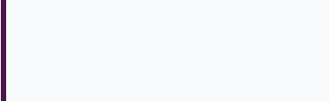
Model Comparison
Tuned Model Results on Test Set (Accuracy):
Model | Baseline Accuracy | Tuned Accuracy
Logistic Regression | 88.59% | 89.13%
Random Forest | 88.04% | 88.59% (Selected)
SVM | 86.96% | 86.41%
Decision Tree | Lowest | 82.07%
Selected Model: Tuned Random Forest
Primary Metric: Recall
F1-Score
ROC-AUC
93.14%
90.48%
93.01%

Slide 12
Stream API Deployment (Streamlit/FastAPI)
•
We developed an interactive Streamlit app to deploy the Tuned Random Forest classifier.
•
The app provides user-friendly input fields for patient clinical parameters such as Age, Cholesterol, Resting BP, and Chest Pain Type.
•
Once inputs are given, the model generates predictions of heart disease risk (Probability Score) in real time.
•
The interface is simple, making it easy for healthcare workers to use without technical expertise.
•
The application supports both Single Patient Prediction and Bulk CSV Prediction for processing multiple records at once.

Slide 13
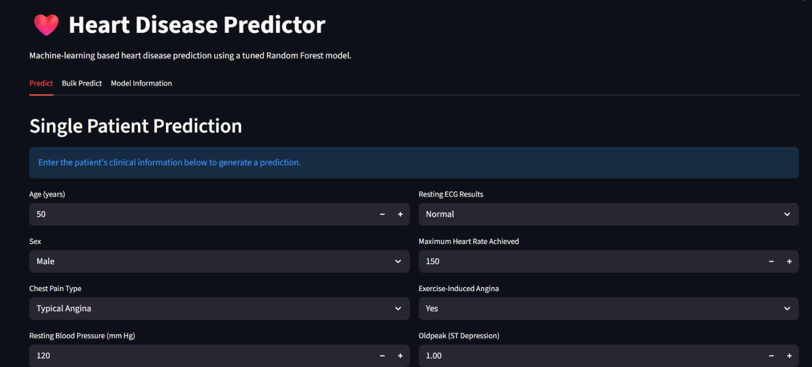
Screenshots:

Slide 14
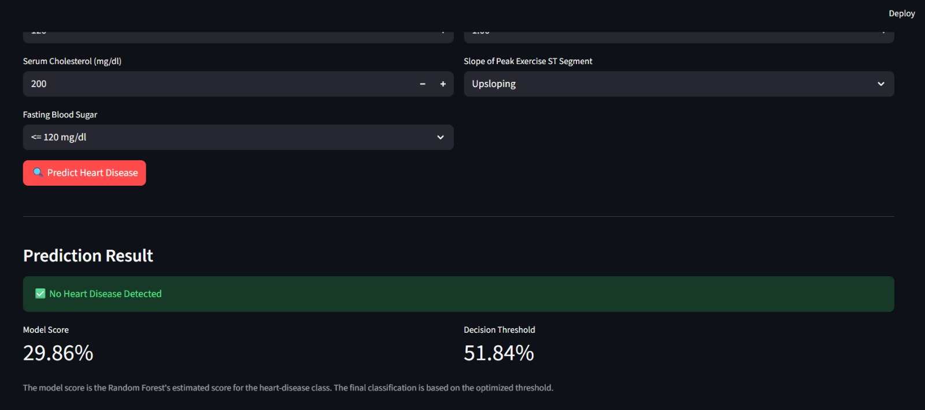

Slide 15
Docker Deployment & CI/CD
•
Create a Dockerfile – Define the environment and instructions to containerize the application.
•
Prepare requirements.txt – List all necessary dependencies for the Streamlit/FastAPI application.
•
Set up docker-compose.yml – Enable service deployment and orchestration.
•
Add .dockerignore – Exclude unnecessary files to optimize the Docker build.
•
GitHub Actions: Implemented CI/CD pipeline to automatically build and publish the Docker image on code push.
•
Docker Hub Image: kiranbelsare/heart-disease-predictor:latest

Slide 16
Conclusion
We built a Machine Learning classification system to predict heart disease risk using 13 clinical demographic and testing parameters. The project involved exploratory data analysis, data preprocessing (scaling and splitting), and model training across 4 classification algorithms.
Evaluated using metrics such as Recall, F1-Score, and ROC-AUC, a Tuned Random Forest was selected and optimized via threshold tuning to achieve a 93.14% Recall rate. The trained model was deployed via a Streamlit interface and containerized with Docker for seamless production-ready deployment. Overall, the project demonstrates an end-to-end data science workflow with practical healthcare screening applications.
Educational project only — not intended for medical diagnosis or to replace professional medical advice.

Slide 17
Any Queries ???
Thank You!

